Slide 1
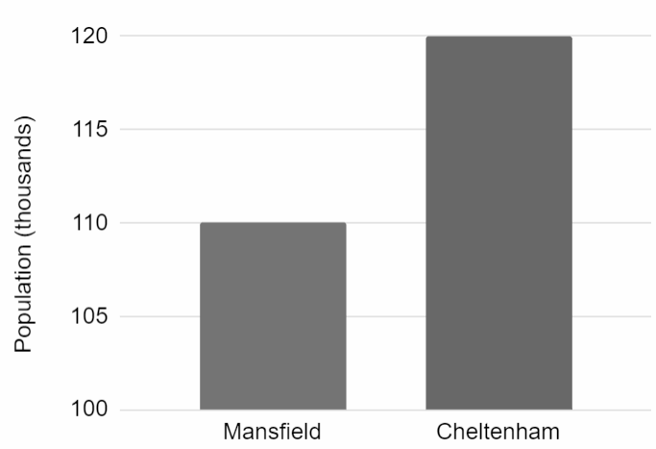


Statistical problems - data presentations
Task A: Presenting data clearly using graphs
1) The graph shows data from the ONS about the population of two towns in 2019.
Cheltenham has twice as many people as Mansfield.
Izzy
a) Explain why Izzy might think this, based on the bar chart.
b) Explain why this is wrong.
2) The table shows data from the ONS about five towns in 2019.
Complete the scale on the axes of the scatter graph.
population (thousands) | number of properties sold
131 | 2012
140 | 2300
156 | 2279
160 | 2390
171 | 2491
2500
number of properties sold
180
population (thousands)

Slide 2


Statistical problems - data presentations
Task B: Choosing how to present data to illustrate a point
1) The table shows weather data from The Met Office for Cardiff in 1995.
month | sunshine duration (hours)
1 | 41
3 | 158
5 | 233
7 | 222
9 | 168
11 | 84
Plot a graph to illustrate how the duration of sunshine changed during the year.
2) The table shows weather data from The Met Office for Cardiff in 1995.
sunshine duration (hours) | max daily temperature mean (℃)
41 | 9
158 | 11
233 | 17
222 | 23
168 | 18
84 | 12
Plot a graph to illustrate the relationship between sunshine duration and maximum temperature.

Slide 3

Statistical problems - data presentations
3) The table shows weather data from The Met Office for four locations in 1995.
location | days with airfrost
Ballypatrick Forest | 23
Cardiff | 33
Durham | 64
Lerwick | 59
Plot a graph to illustrate how the total number of days with airfrost differs between the four locations.
Mathematics in Education and Industry
v2.1

